Slide 1
STUDENT INFORMATION & MANAGEMENT SYSTEM (APPLICATION & WEBSITE)
Techno Engineering College Banipur.
PRESENTED BY :
Akash Sarkar (24400119017)
Ritwik Paul (24400119042)
Rupam Das (24400119027)
Sayan Malakar (24400119016)

Slide 2
CONTENTS:
Problem Definition
Why Mobile App?
Why Website?
Hardware and Software Specifications.
Features
Objective
Database & Hosting
Flowcharts
Limitations
Future Scope
Conclusion
References

Slide 3
Problem Definition:
In this era of technological development, having a mobile application to help a student cope up with all his college progress, courses, notices and updates and use the same application for maintaining and keeping track of all necessary and relevant students information by the students can be a great ease, help, accuracy and zero data redundancy.
And the same goes to the website too, Having a full-fledge working website which let’s our Principal, Teachers, Class-Teachers and librarian manage all the Students in a single place.
Institution can publish notices, give updates or make announcements at any time and students can have access to the data instantly from anywhere.
Students will have access to courses instantly from anywhere.
Using the application for taking attendance and keeping track or student progress will help get rid of human made errors and will be done in less time.
Switching to this technology will save paper.
An information and management system which can provide individualized services to students by use of latest technology can increase popularity of institution.
This app and website will be able to reduce the hassle of student management by 25 to 30%, means it will be a efficiently optimized method.

Slide 4
Why Mobile Application?
In traditional approach, Students cannot receive the information if they are not physically present in college. Moreover, it wastes lot of paper.
The major challenge in obtaining information from website is that, it provides collective information to large groups of students.
Students will have access to courses instantaneously from anywhere.
Institution can publish notices, give updates or make announcements at any time and students can have access to the data instantaneously from anywhere.
Using the application for taking attendance and keeping track of student progress will help get rid of human made errors.
Managing library information and Accounts will be a piece of cake.

Slide 5
Why Website?
In professional fields all prefer website over applications, and they use Laptop/ Desktop instead of mobile phones.
Would be easy to manage account section or library section rather than using applications, as they need to deal-with the large amount of students data.
For long working sessions Website is more comfortable than applications, specially for aged persons.
For huge amount of data-entry works Desktop/ laptop keyboards are more comfortable and optimized to type with more accuracy and in a efficient manner.
Admins can manage students data by adding , updating, deleting them and students will have no access on that admin part.
Publishing results , Fees structure, Study materials, information , holiday announcements , placement talks with a push notification option to the application will be very easy.

Slide 6
Hardware Specifications: Application:
1
For developing application:
RAM : 16 GB or higher
Memory : 40 GB free space in the installation drive
Processor : i5 11th Gen Processor (2.5GHz or higher)
Graphics : GTX 1650 4GB.
For running application:
RAM: 1 GB and higher
Processor: Any Mediatek / Qualcomm chipset.
Minimum SDK: API level 19 ( Android version 4.4 KITKAT)

Slide 7
Hardware Specifications: Website:
2
For developing Website:
RAM : 4 GB or higher
Memory : 6 GB free space in the installation drive
Processor : i3 10th Gen Processor (2.0GHz or higher)
For running Website:
RAM: 1 GB or higher.
Processor: Dual core CPU, [e.g- core 2 duo, Pentium, Celeron minimum]
Browser: Chrome, Firefox, Internet Explorer, Edge, Safari, Opera,
Brave, Chromium, Vivaldi, DuckDuckgo.

Slide 8
Features:
Keep track of student attendance and perform necessary calculations.
Provide separate login for administrator and students.
Empower administrator to Add, Update and Delete student information easily.
Check student performance and progress.
View semester and internal marks and keep track of old records.
Provide necessary and urgent notice to all students.
Keep track of courses.
Keep track of teacher activities individually by admins.
Student feedback for teachers.

Slide 9
Objective:
To provide a proper registration channel/system to the new students by keeping that authority only to the faculty.
To maintain all records of the student in digital from enrollment up to the study .
To take attendance of student and perform the necessary calculations, without maintaining a attendance book.
To update the information available to the department at their desk whenever required in just a touch. And admins or higher authority can manage everyone at the same time.
To have a centralized control over the record of students and teachers even the job done by each college in a day.

Slide 10
Database: SQL and PHP
1
SQL is a domain-specific language used in programming and designed for managing data held in a relational database management system, or for stream processing in a relational data stream management system.
SQL is an open-source relational database i.e. used to perform database operations on android devices such as storing, manipulating or retrieving persistent data from the database.
PHP is an open-source server-side scripting language for web development. It is also a general-purpose language and Its GUI is very easy to maintain.
At the same time it’s a powerful weapon to web devs.

Slide 11
Hosting the website and fetching it to the application: AWS (AMAZON WEB SERVICES)
2
Amazon Web Services, Inc. is a subsidiary of Amazon that provides on-demand cloud computing platforms and APIs to individuals, companies, and governments and so far reliable.
On a metered pay-as-we-go basis. And Initially its giving some features free (for the limited time though).
It’s super fast and optimized so no app/website crashing issues.
These cloud computing web services provide distributed computing processing capacity and software tools via AWS server farms.
And last but not the least it can handle the application servers very efficiently so 0% data redundancy.

Slide 12
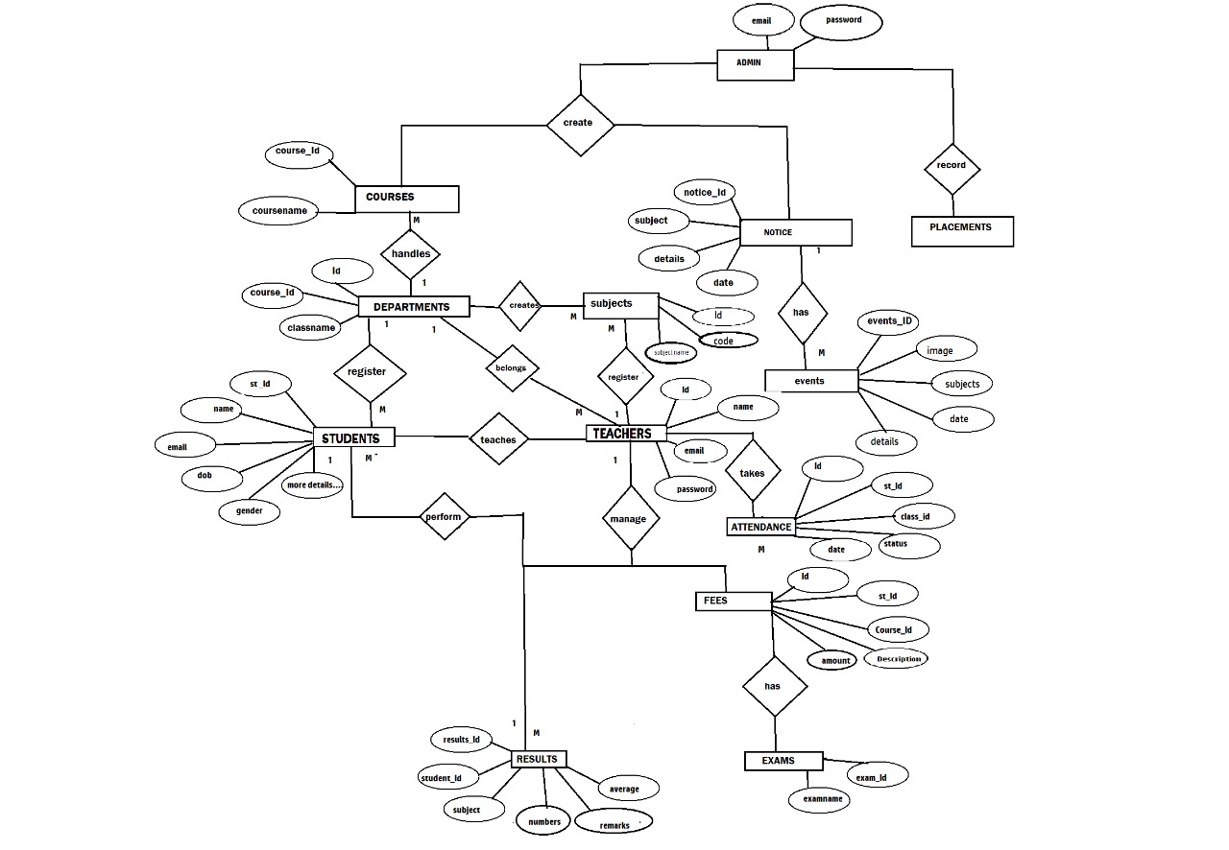
Flowcharts: E-R Diagram

Slide 13
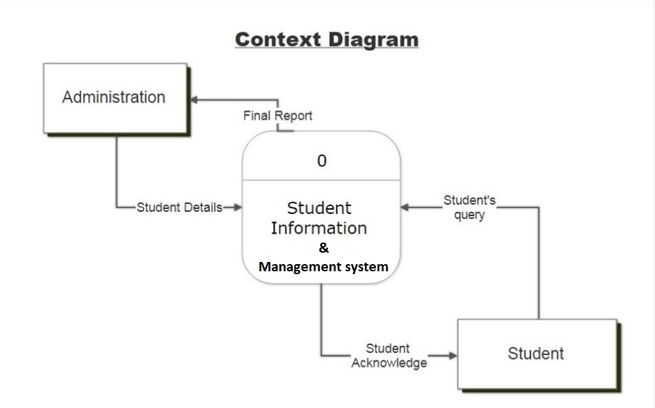
Flowcharts: Context Free Diagram

Slide 14
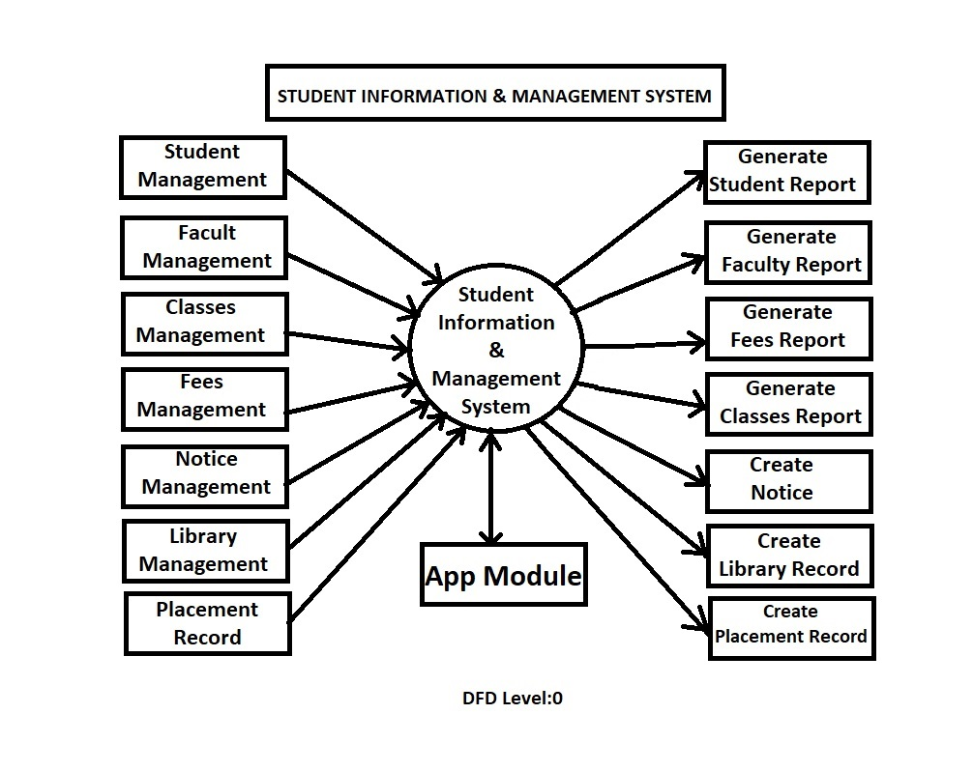
Flowcharts: Data Flow Diagram – Level 0

Slide 15
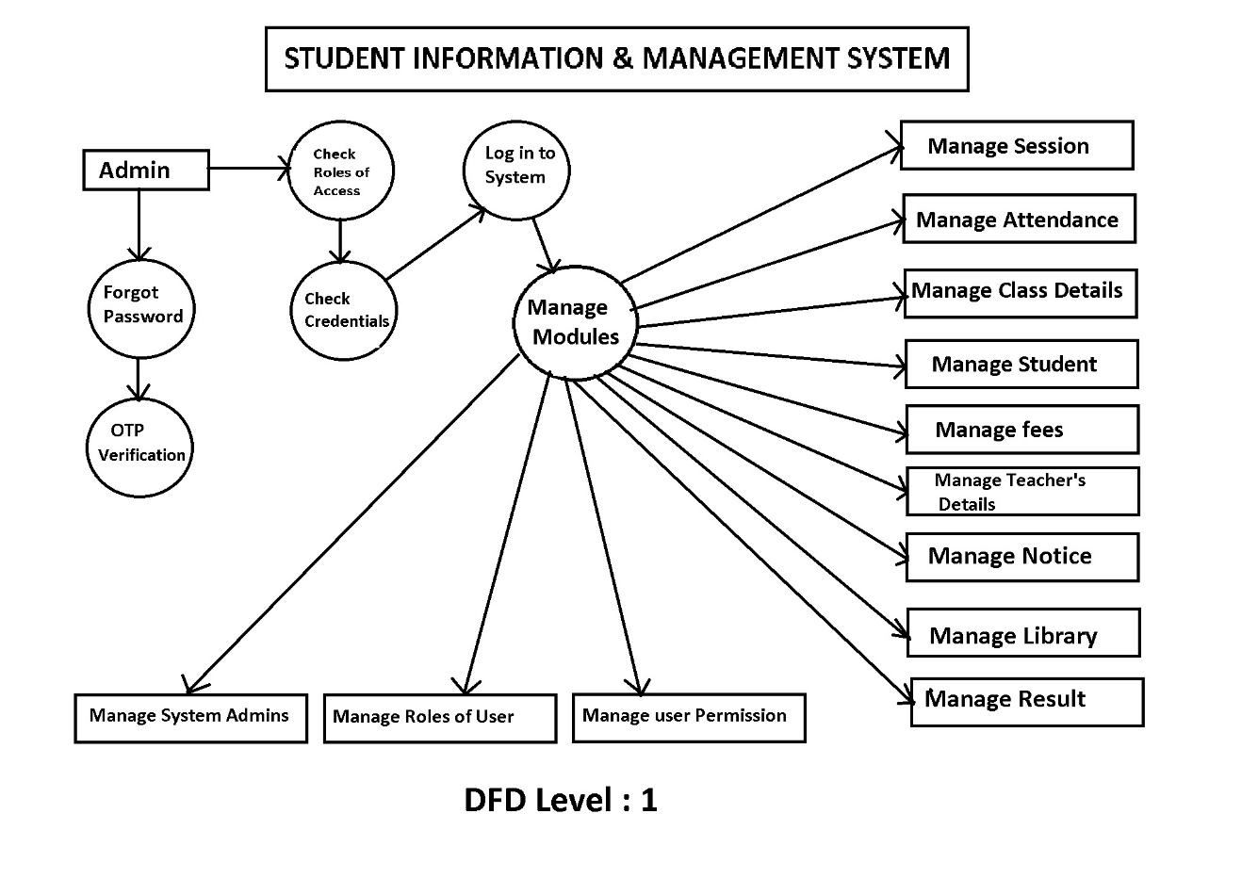
Flowcharts: Data Flow Diagram – Level 1

Slide 16
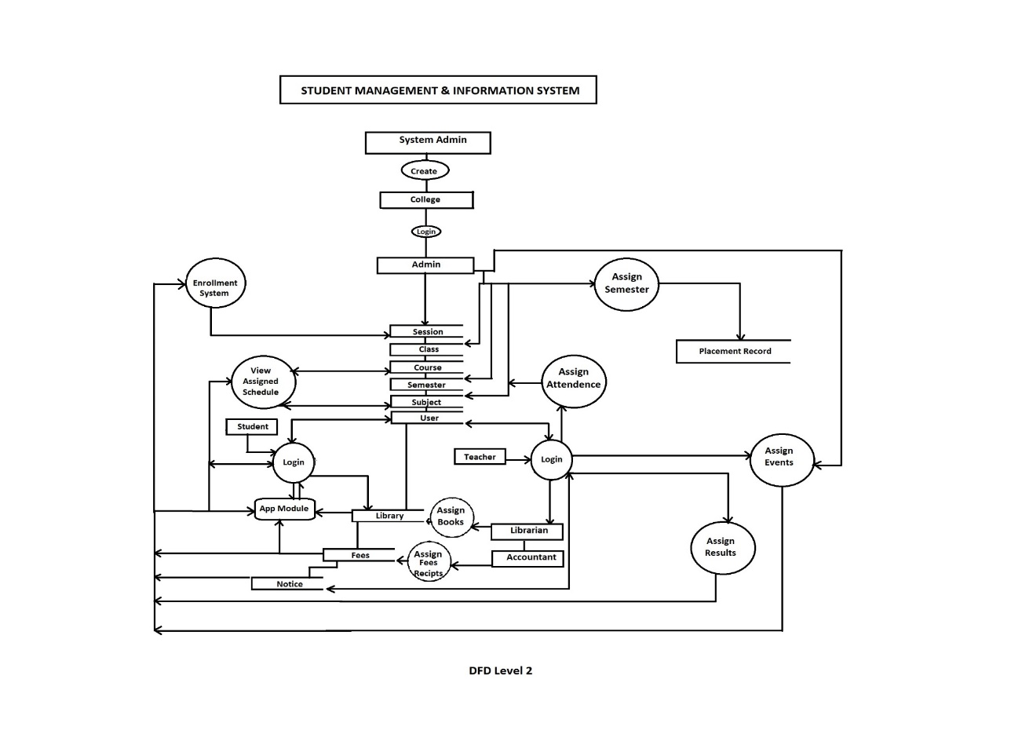
Flowcharts: Data Flow Diagram – Level 2

Slide 17
Limitations:
Cannot be used by a non smart-phone user.
IOS (iPhone) users have no native application yet.
SQL is back dated now a days and it might be vulnerable.
Due to security requirement, student can not use all utilities and modify system settings.

Slide 18
Future Scope:
Student Information and Management System can be integrated with M-learning platforms and Location based features such as locating nearest computer center, locating nearest restaurant etc.
This app & website can also include Fee Payment feature which shows their fee payment schedule and Reminder alerts.
A access can also be provided to admins so that they can keep track of the performance and progress of their teachers & Students.
Implementation of a system that informs about the on going activities in the college might be possible.
We may implement IOS based application later.
Website can be made more optimizes later by using some latest Techs like spring APIs , Node JS and others.

Slide 19
Conclusion:
Today’s student community and their expectations with regards to instant and personalized availability of information on their mobile devices is pushing more and more educational institutes to have a mobile/app presence. As the educational institutes embark on this journey they will need to decide whether to build a completely new technical architecture to support the app-based delivery of information, or, to re-use their existing infrastructure (database, web-servers) using SOA (service oriented architecture) to enable the same. We propose an architecture that reuses existing infrastructure using SOA for app based delivery of information to the students. The architecture is stable, resilient and scalable to incorporate the diverse needs of students and various College departments under Techno India University. Also the Website is exact same to the actual official website and is working very fine. Seems this idea will reduce the human hassle by 80% and reduce paper usages by at least 60% according to our calculation.

Slide 20
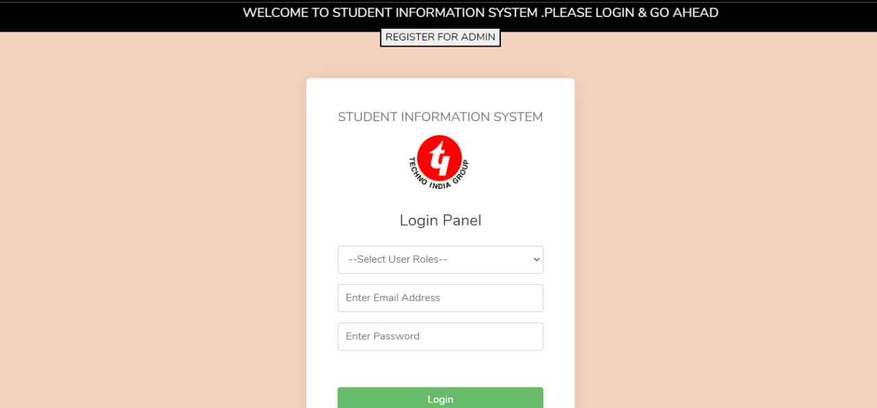
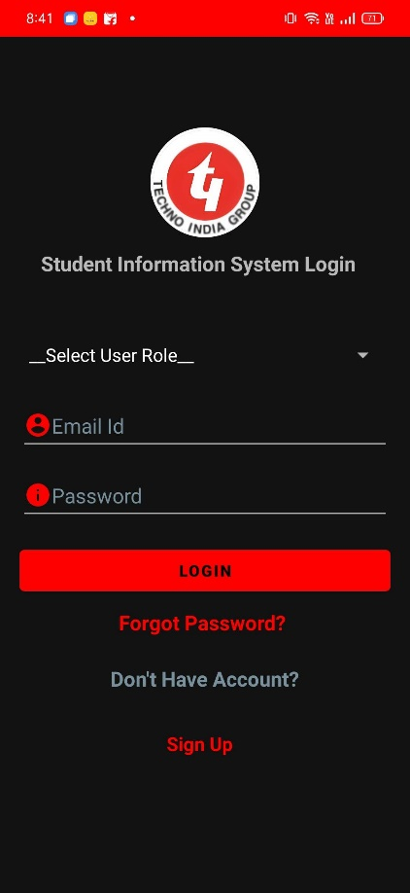
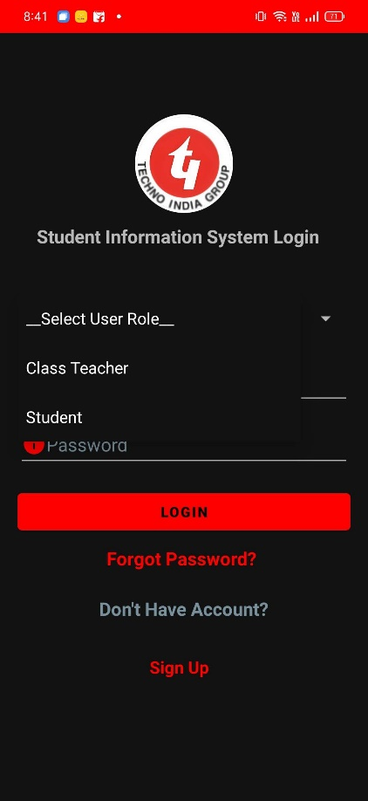
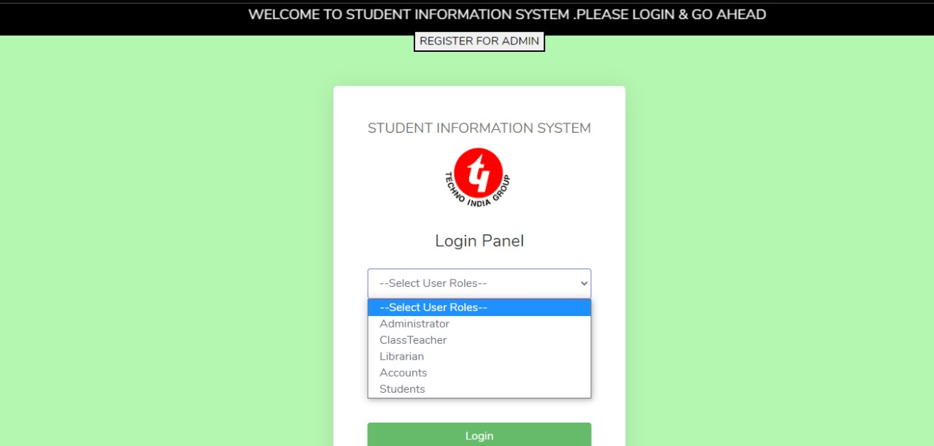
Login Page

Slide 21


Slide 22


